Slide 1
Updates
05/05/2021

Slide 2
Gantt
https://docs.google.com/spreadsheets/d/1oa-Z-vQIIZ6xVn4PNoHb93SB0EdPG6uHLpalY9HMLck/edit#gid=0

Slide 3
Experimentation Variables
Damage Geometry
T1, T4
Compression vs tension
Infill percentage
20%,40%,60%,80%,100%
Infill pattern
Rectilinear (All initial tests done in rectilinear)
Hexagonal
Concentric(aligned)
Material
Pla
ABS
Carbon Fiber PLA

Slide 4
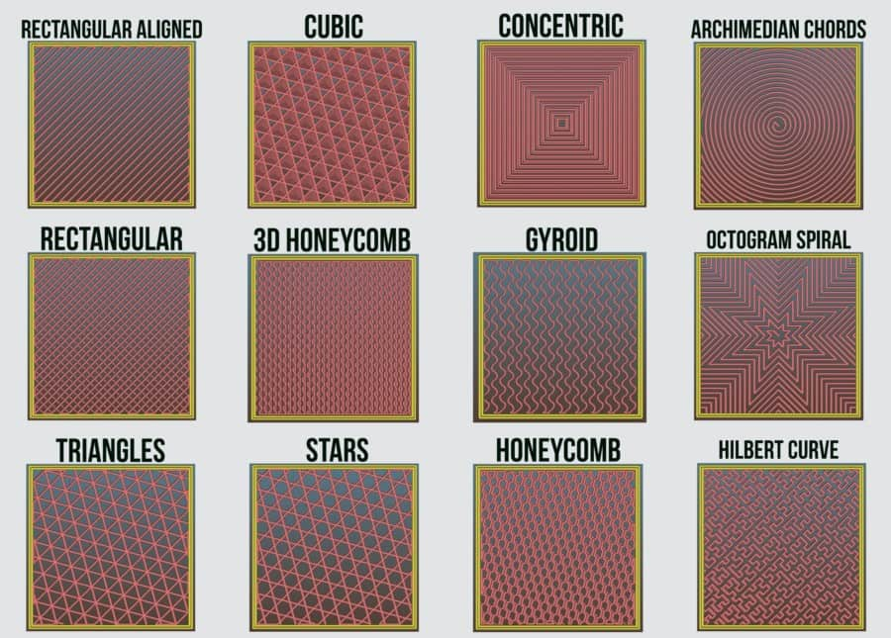
Printing patterns

Slide 5
Printing done
6 samples each of T1 40,60,80 % rectilinear for compression
All T1 aligned (concentric) finished
40,60,80% for tension and compression
Summer Work: ABS and Carbon Fiber printing

Slide 6
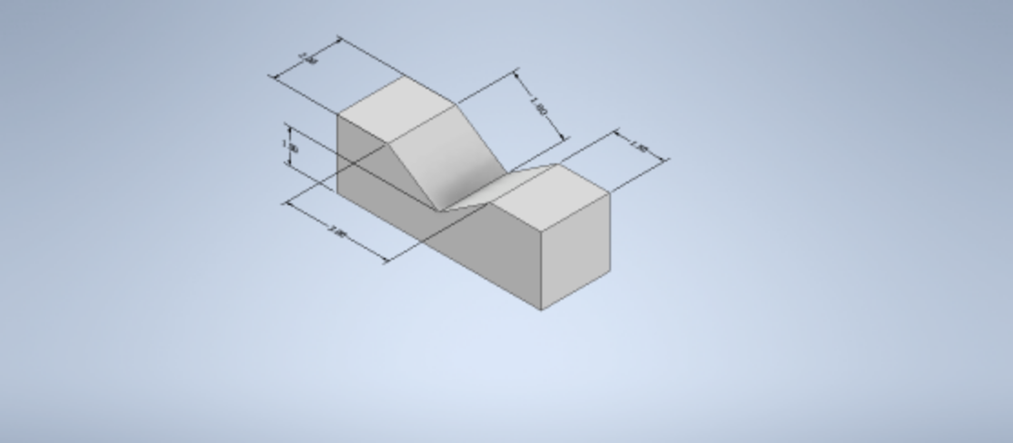
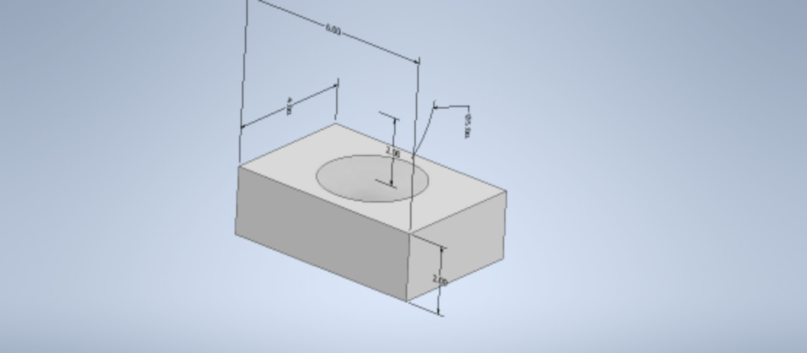
Printing base structures (damages)
T1
T4

Slide 7
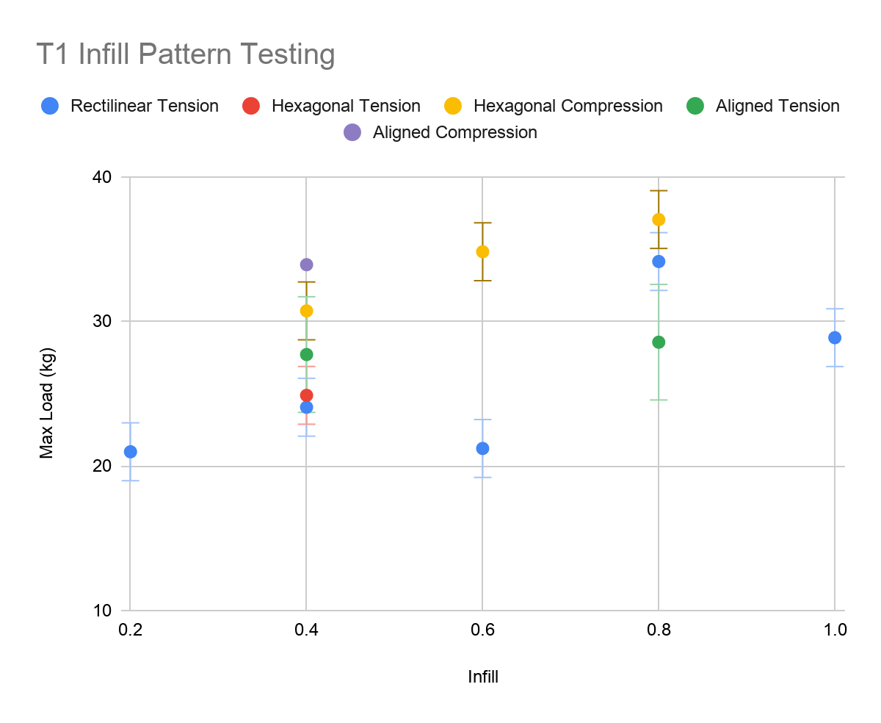
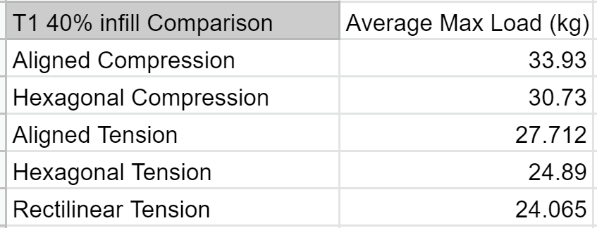
Experimentation
New Data
Working through aligned pieces
T1 40% aligned tension
T1 40% aligned compression
T1 80% hexagonal compression
T1 60% hexagonal compression
Aidan's Bars
Need Eric’s data to compare
40% infill has most patterns finished
Compression is the strongest
Hexagonal is very close to rectilinear in tension
Aligned is greater than both in tension

Slide 8
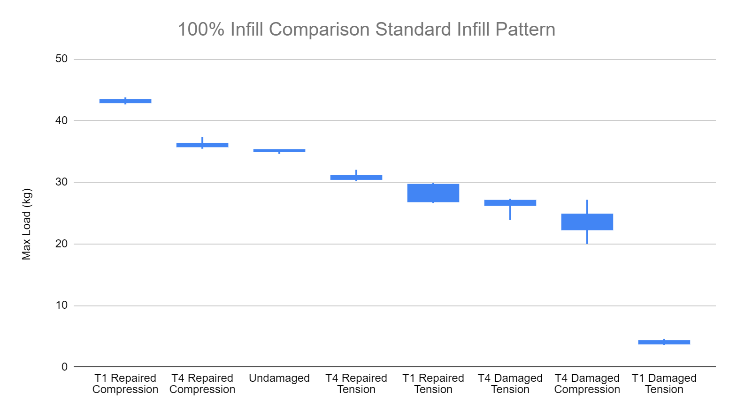
Summary/Findings
Compression always stronger than tension
In some cases stronger than the control
T1 and T4 repairs in tension are similar
T1 stronger in compression
Strength generally increase with percentage infill
80% infill stronger than 100%
Initial results from Infill Pattern testing
Hexagonal and Rectilinear have similar strength in tension
Aligned is stronger than both in tension
Aligned is stronger than hexagonal in compression

